Slide 1

Types and Type Checking
(What is it good for?)
Stephen Chang
Racket Summer School 2018
(Thursday morning)

Slide 2
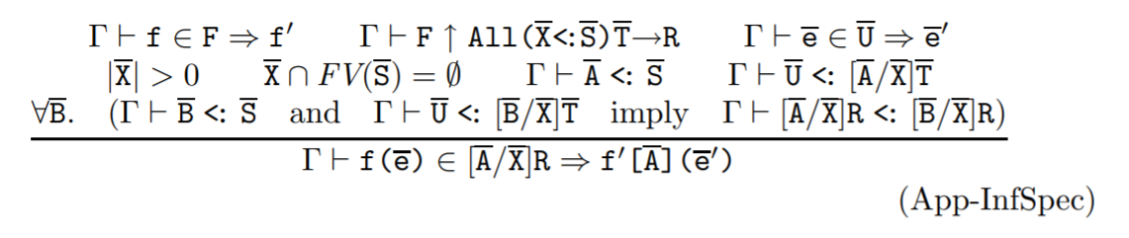
A quick survey
?

Slide 3



The Holy Grail of PL Research …
(one of)
… is to predict behavior of programs
(without running them)
Prevent bugs
Avoid malware
Prove equivalence

Slide 4
Abandon all hope?
“All non-trivial, semantic properties
of programs are undecidable”
--- Rice’s theorem

Slide 5



Enter … Type Systems
“A lightweight, syntactic analysis
that approximates program behavior”
Validate function arguments
(Prevent bugs)
Check memory safety
(Avoid malware)
Verify program properties
(Prove equivalence)

Slide 6
Typed Languages
Surface code
Reader / Lexer / Parser
Yesterday
AST (e.g., syntax objects)
Type Checker
Today
Checked AST
Compiler (includes macro expander)
Core code / bytecode / machine code

Slide 7
How to create typed languages?
Incorporate types into the grammar.
Come up with a language of types.
Develop type rules for each language construct.
Implement a type checker.

Slide 8
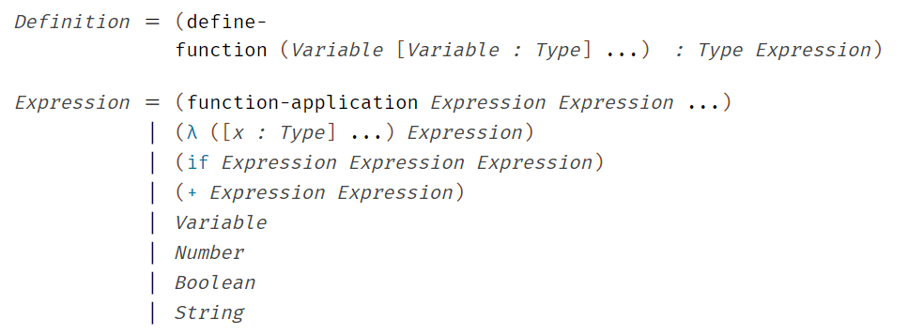
How to create typed languages?
Incorporate types into the grammar

Slide 9
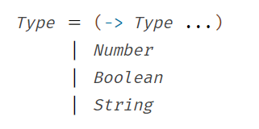
How to create typed languages?
2. Come up with language of types

Slide 10
Specifying Type Systems: Inference Rules
3. Develop type rules for each language construct.
Premise 1
IF:
Premise 2
Premise 3
THEN:
Conclusion

Slide 11
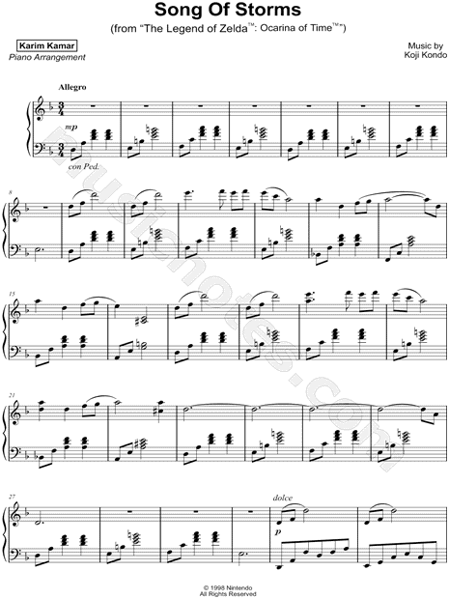

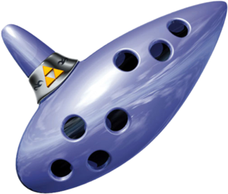








If type systems were a video game …
IF:
THEN:

Slide 12
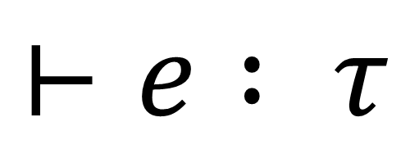
Type Judgements
$$⊢e : τ$$
“It is true, that expression e has type τ”

Slide 13
How to create typed languages?
3. Develop rules for each language construct

Slide 14
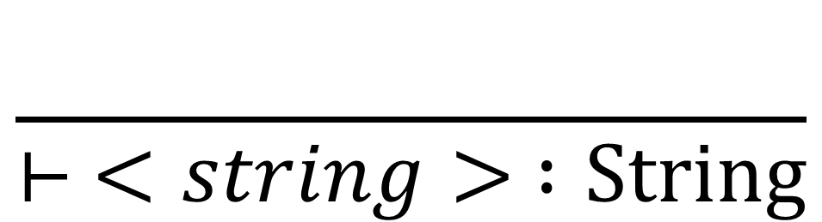
A rule for string literals
$$\frac{}{⊢ <string> :String}$$
“It is true, that string literals have type String”

Slide 15
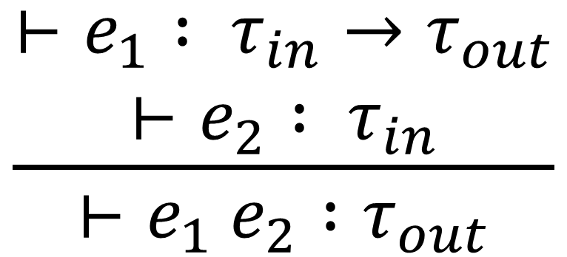

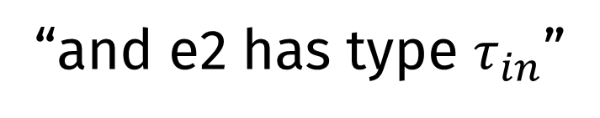
Function Application Type Rule
“If: it is true, that expression e1 has type $τ_{in}→τ_{out}$”
“and e2 has type $τ_{in}$”
$$\frac{\begin{aligned}⊢e_{1} : τ_{in}→τ_{out} \\ ⊢e_{2} : τ_{in}\end{aligned}}{⊢e_{1} e_{2} :τ_{out}}$$
“Then: it is true that e1 e2 has type $τ_{out}$”

Slide 16
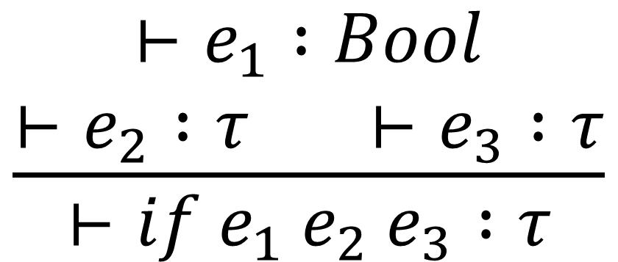
If Type Rule
$$\frac{\begin{aligned}⊢e_{1} :Bool \\ ⊢e_{2} :τ ⊢e_{3} :τ\end{aligned}}{⊢{if e}_{1} e_{2} e_{3} :τ}$$

Slide 17
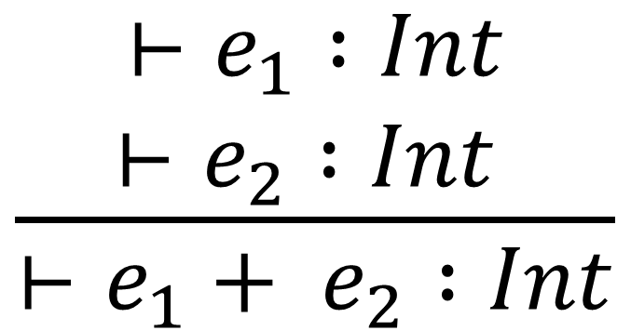
Plus type rule
$$\frac{\begin{aligned}⊢e_{1} :Int \\ ⊢e_{2} :Int \end{aligned}}{⊢e_{1}+ e_{2} :Int}$$

Slide 18
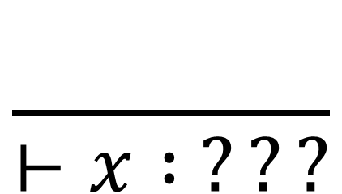
Variables?
$$\frac{}{⊢x : ???}$$
A variable’s meaning depends on its context

Slide 19




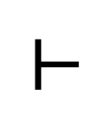
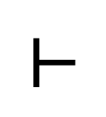
$$⊢$$
$$⊢$$

Slide 20

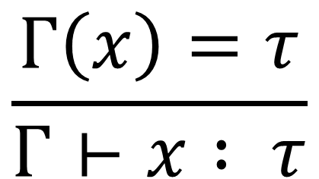
Variables : Type depends on context
“In context Γ, x has type τ”
$$\frac{Γ\left(x\right)=τ}{Γ⊢x : τ}$$
Context (or Type Environment)
$$Γ= x :τ,…$$

Slide 21
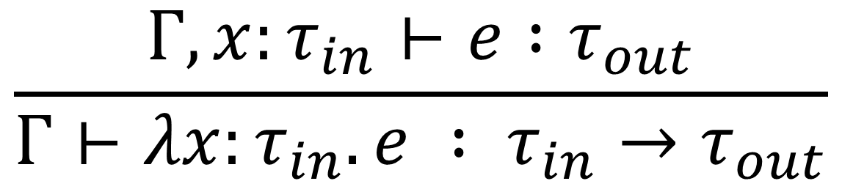
Type rule for lambda functions
“In context Γ, extended with
x, which has type τin, e has type τout”
$$\frac{Γ, x:τ_{in}⊢e :τ_{out}}{Γ⊢λx:τ_{in}.e : τ_{in}→τ_{out}}$$

Slide 22
From Type System … to Type Checking
These type rules say nothing about how to check types,
i.e., they are not an algorithm

Slide 23
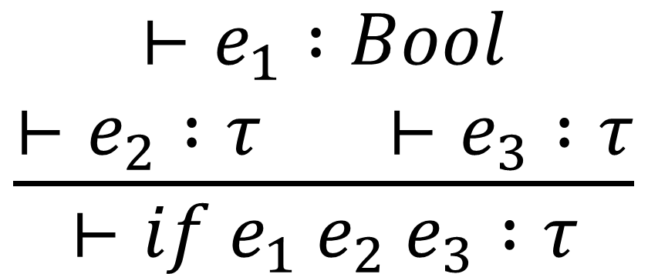
If rule: a specification
$$\frac{\begin{aligned}⊢e_{1} :Bool \\ ⊢e_{2} :τ ⊢e_{3} :τ\end{aligned}}{⊢{if e}_{1} e_{2} e_{3} :τ}$$
IF: e1 has type Bool, and e2 has type τ, and e3 has type τ
THEN: if e1 e2 e3 has type τ

Slide 24
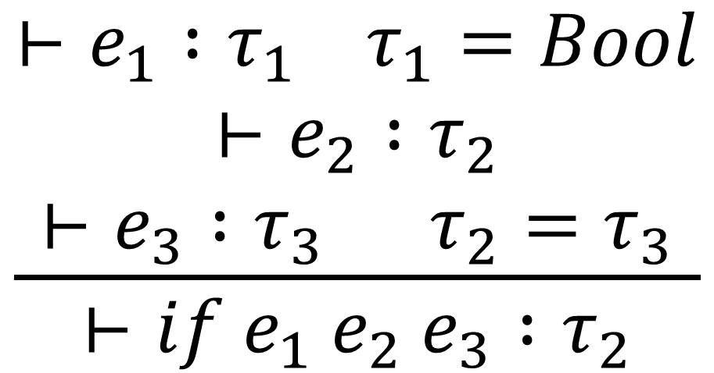
If rule: a checking algorithm
$$\frac{\begin{aligned}⊢e_{1} :τ_{1} τ_{1}=Bool \\ ⊢e_{2} :τ_{2} \\ ⊢e_{3} :τ_{3} τ_{2}=τ_{3}\end{aligned}}{⊢{if e}_{1} e_{2} e_{3} :τ_{2}}$$
Compute e1’s type: τ1
Check that τ1 is Bool
Compute e2’s type: τ2
Compute e3’s type: τ3
Check that e2’s type equals e3’s type
Assign (if e1 e2 e3) e2’s type

Slide 25
“Bidirectional” judgements: better for specifying algorithms
⇐ = “check” the type
⇒ = “compute” the type

Slide 26
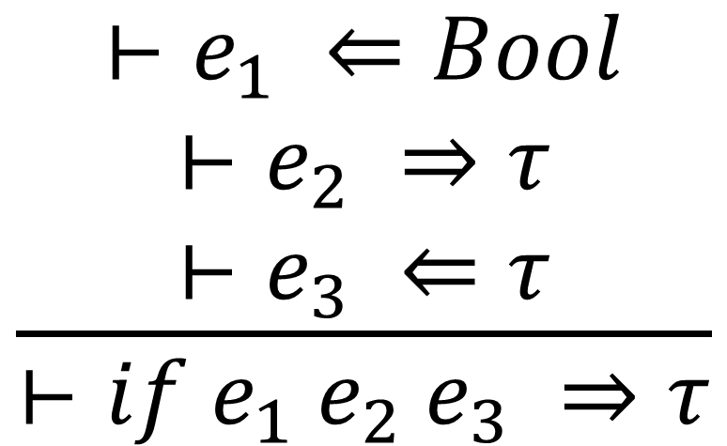
A bidirectional If rule
$$\frac{\begin{aligned}⊢e_{1} ⇐Bool \\ ⊢e_{2} ⇒τ \\ ⊢e_{3} ⇐τ\end{aligned}}{⊢{if e}_{1} e_{2} e_{3} ⇒τ}$$
Check that e1 has type Bool
Compute e2’s type as τ
Check that e3 has type τ
Assign (if e1 e2 e3) type τ

Slide 27
“Bidirectional” judgements
⇐ = “check” the type
⇒ = “compute” the type
But now we have two judgements!

Slide 28
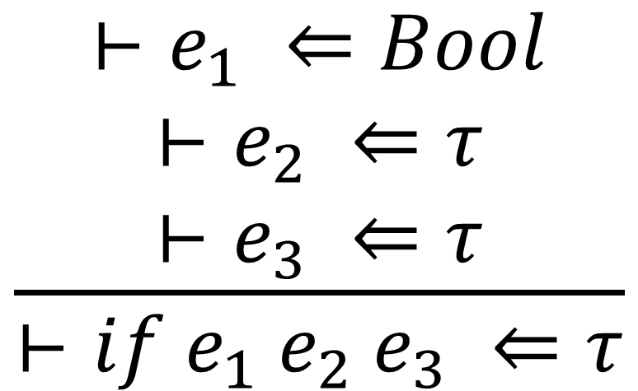
Another bidirectional If rule
$$\frac{\begin{aligned}⊢e_{1} ⇐Bool \\ ⊢e_{2} ⇐τ \\ ⊢e_{3} ⇐τ\end{aligned}}{⊢{if e}_{1} e_{2} e_{3} ⇐τ}$$
Check that e1 has type Bool
Compute e2’s type as τ
Check that e3 has type τ
Assign (if e1 e2 e3) type τ

Slide 29
LAB, part 1
Develop bidirectional rules for our language. Focus on the expressions first.
It might help to first review the “conventional” type rules.
Make sure to come up with both “check” and “compute” versions of the bidirectional rules.

Slide 30
LAB, part 2
Use your rules to implement a “compute” type checking function.

